Slide 1
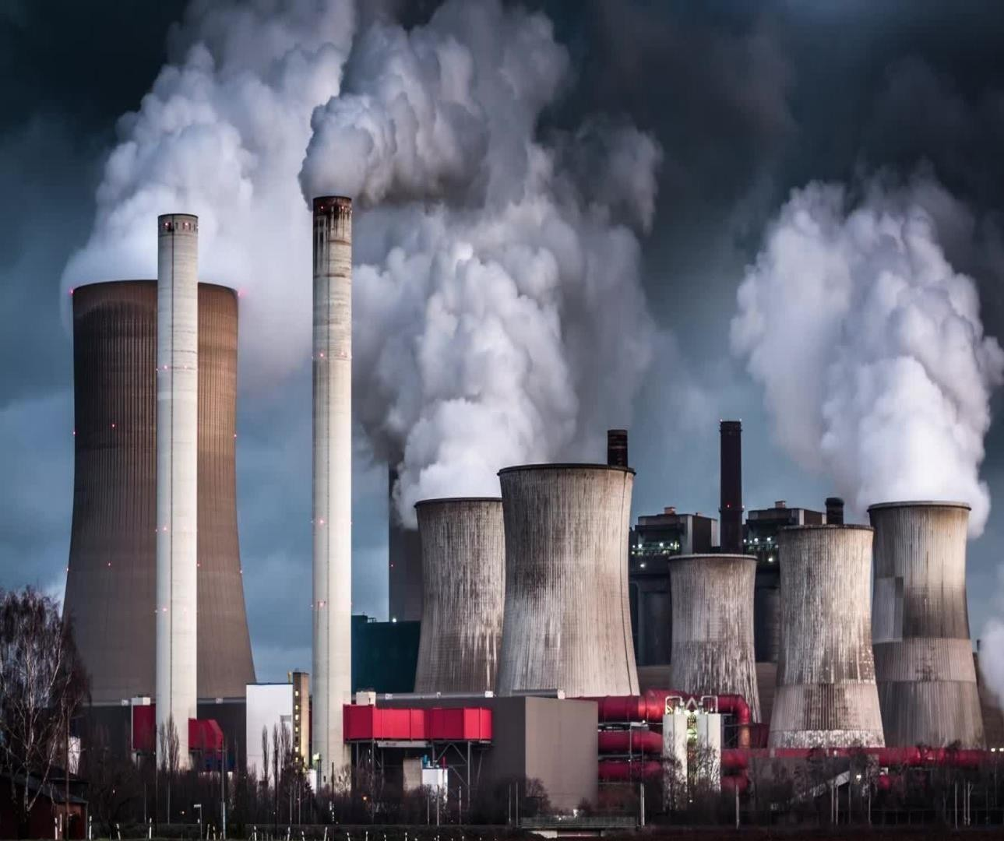
PUBLIC TRANSPORTATION OPTIMIZATION
PRESENTED BY,
SONIYA.D MAYILI.A
BHUVANESHWARI.A JANANI.R NARMADHA.S DEVI.R
A.R ENGINEERINGCOLLEGE.

Slide 2



ABSTRACT
Transportation refers to the movement of people, goods and services from
one place to another.
Internet of things is a platform that the device used to be smart, every day
is processed to be smarter, and everyday communication becomes
more informative.
Public transportation optimization aims to propose an integrated transportation system model for catering the convenience and safety needs especially in the developing countries context.
A new framework for public transport optimization based on IOT
which integrates the scheduling problem of subway, bus and shared taxi
is proposed for better coordinated transfer solution.
It improve the quality of population life.

Slide 3



Nowadays the rapid economic growth of modern cities also causes many
serious problems; one of them is traffic congestion.
In Beijing, the Capital of china, people waste over three hours each
day stuck in traffic in workdays.
In order to better connect with bike- sharing, car-sharing, and other modes of transportation , public transportation will carry out important reforms, among which the optimization of line network is one of the most important task.
It provides a comprehensive decision making method for improve the network topology structure and actual operation of public transit network.
The internet of things provides a windows of opportunity for public
transportation system.
It provides better control strategies and scheduling scheme ,thus can
more efficiency utilize the transportation resources and improve the quality of public transportation.

Slide 4
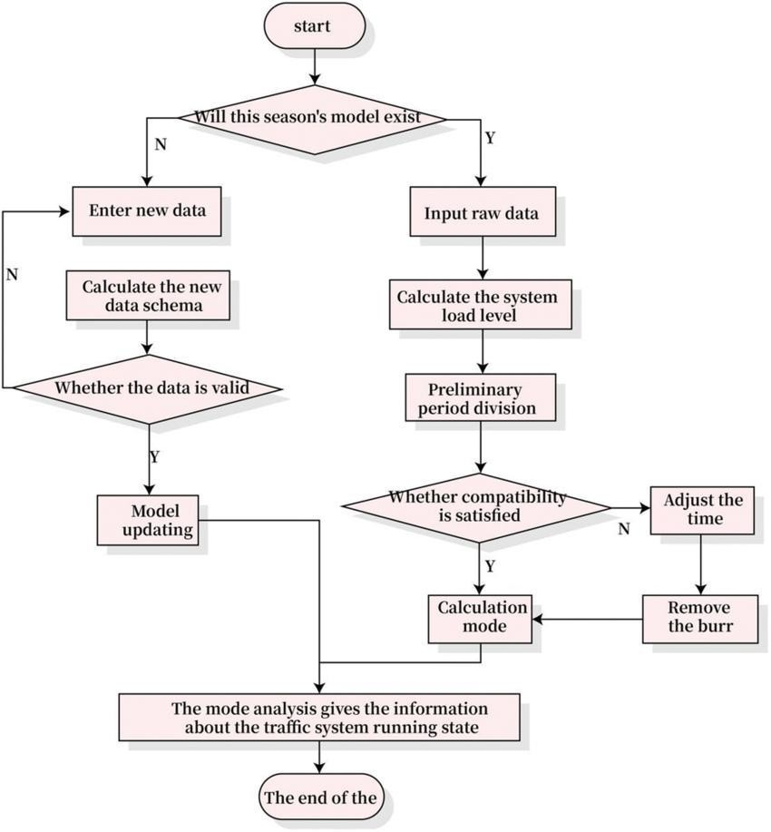
BLOCK DIAGRAM

Slide 5



DESCRIPTION
Big data uses network information technology in an extremely large number of information system quickly process and analysis this huge data information.
In this way, the INTERNET OF THINGS system has the characteristics of
rapidness , high efficiency , low density and strong authenticity.
The main working mechanism of cluster analysis is to classify similar objects according to the correlation of different data in the objects.
Through the analysis of various road traffic problems, the possibility of
optimizing traffic through big data and the INTERNET OF THINGS is created.
To improve the public transportation optimization management of the latest information in the transportation system requires the use of information technology and data management systems.

Slide 6
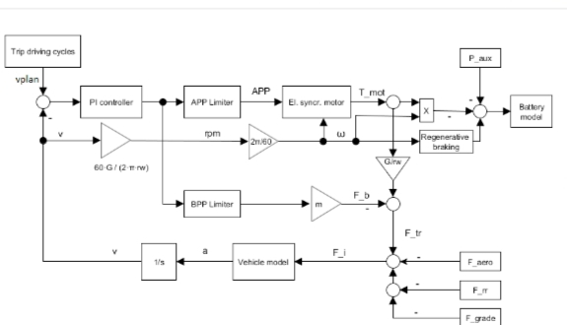
CIRCUIT DIAGRAM

Slide 7
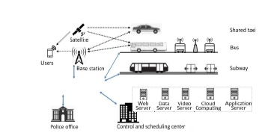
COMMUNICATION NETWORK OF PUBLIC TRANSPORTATION OPTIMIZATION

Slide 8
WORKING PRINCIPLE
Public transportation optimisation is the essential one for transportation and it satisfice the basic travel demand of Citizens.
In recent years the greatest interest in Public transportation system and lot of research papers that are Published around this topic.
Public transportation optimisation May be defined as Any form of passengers That is available for hire and reward.
In practice, it’s usually refers to passenger transport in particular bus and train services.

Slide 9
SOFTWARE
We are using the python software for the public transportation optimization.
Python is a interpreted, object oriented and high level language.
It was developed by the Guido van Rossum.
It was developed in the year of 1991.
Designed to be easy as well as, fun the name python is nod to the British comedy group Monty python.
It is the beginners friendly language , replacing java as the most widely used introductory language because it handles much of the complexity for the user, allowing beginners to focus on fully grasping programming concepts rather than minute details.

Slide 10
THANK YOU

